Slide 1

$$〈\text{QC}|\text{−}|\text{IL}⟩$$
First Steps in QC & QML
(Quantum Computing & Quantum Machine Learning)
Yossi Eliaz
March 2020

Slide 2
Plan
Introduction to the book cover and preliminary background
Chapter 1 + 2 :
QUBIT, OR, NOT, NAND, Superposition, entanglement and reversibility
History
Qubits and operators:
BIT vs QUBIT, vector presentation, red, blue
NOT, XOR, NANS
Universal set: CNOT, H, T
Example NAND classical
Chapter 5 Quantum Computers
Cirq:
Introduction to python and google colab
NOT, CNOT, H, T
Teleportation
ML + QML:
What’s machine learning
MNIST TF
Many worlds QML

Slide 5
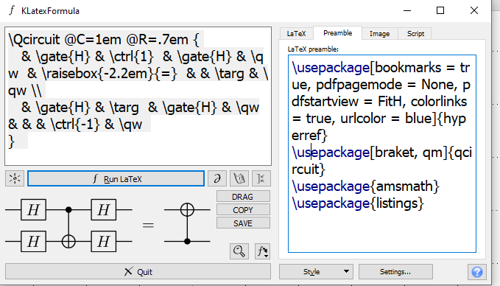
\Qcircuit @C=1em @R=.7em {
& \gate{H} & \ctrl{1} & \gate{H} & \qw & \raisebox{-2.2em}{=} & & \targ & \qw \\
& \gate{H} & \targ & \gate{H} & \qw & & & \ctrl{-1} & \qw
}
\usepackage[bookmarks = true, pdfpagemode = None, pdfstartview = FitH, colorlinks = true, urlcolor = blue]{hyperref}
\usepackage[braket, qm]{qcircuit}
\usepackage{amsmath}
\usepackage{listings}

Slide 6
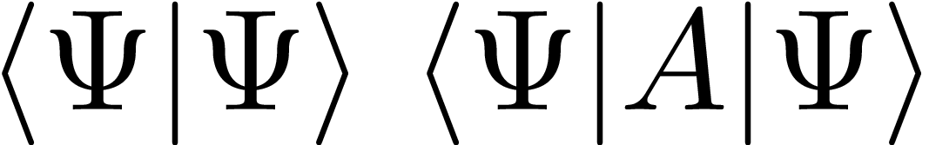
\bra{\Psi}\ket{\Psi} \expval{A}{\Psi}
\usepackage[bookmarks = true, pdfpagemode = None, pdfstartview = FitH, colorlinks = true, urlcolor = blue]{hyperref}
\usepackage[braket, qm]{qcircuit}
\usepackage{amsmath}
\usepackage{listings}
\usepackage{braket}
\usepackage{physics}

